Slide 1
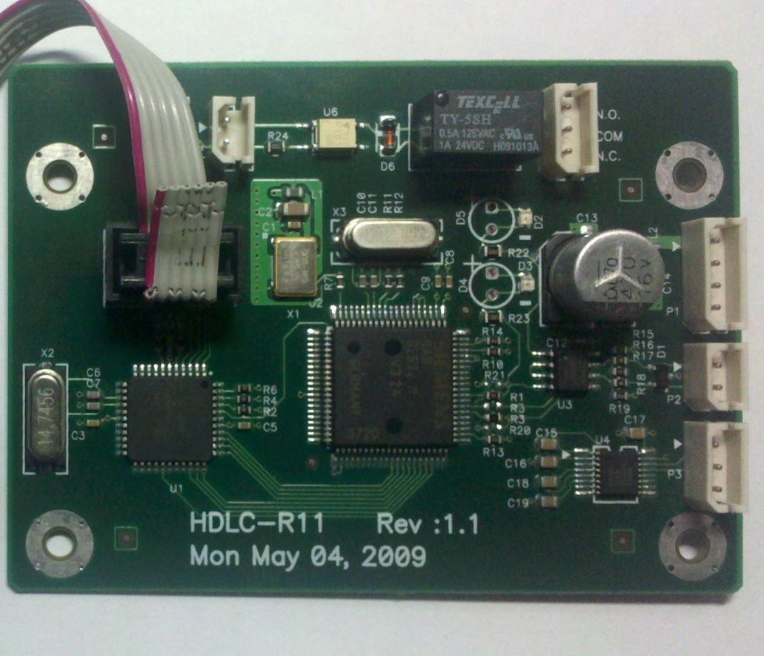
RS-3/9 HDLC Service
2015. 11. 11
Inter-m

Slide 2
Contents
Tool list
Upload procedure

Slide 3
1. Tool list
Upload tooss
LAPTOP

Slide 4

2. Procedure
1.
LAPTOP
USB
+5V
DVR

Slide 5
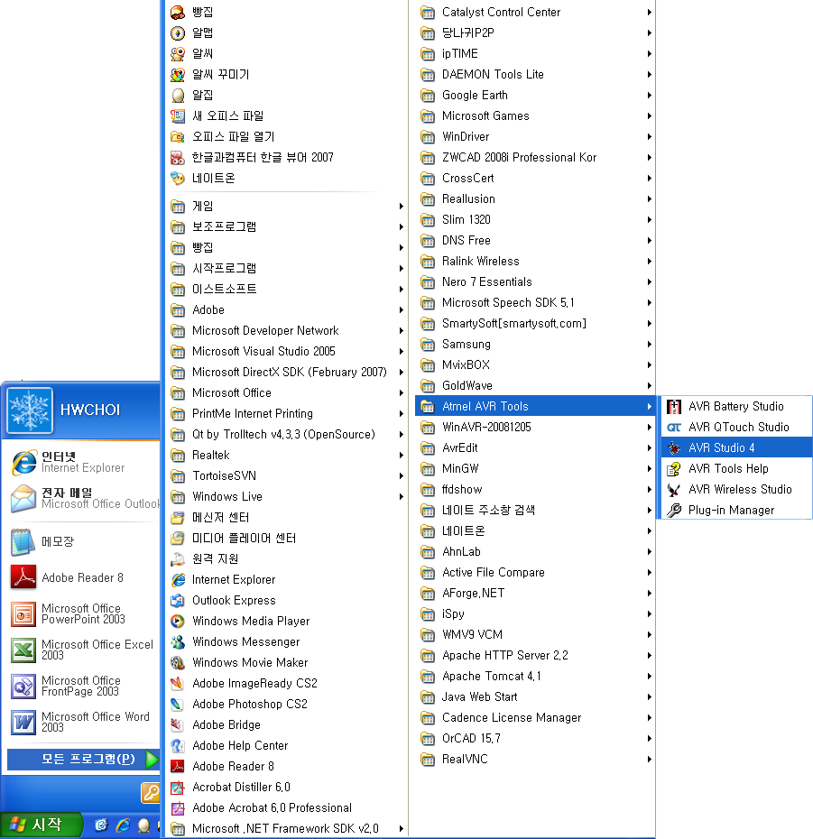
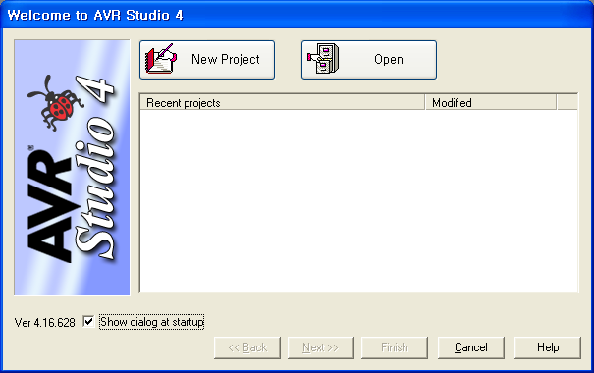
2. Procedure
2.. Run AVR stdudio.

Slide 6
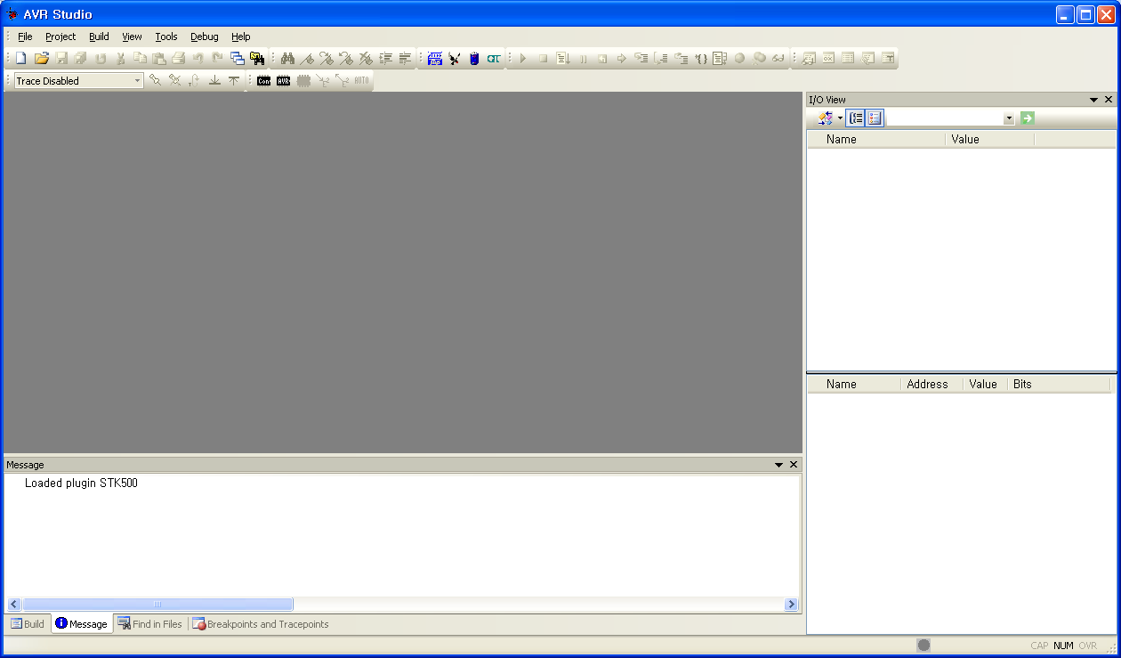
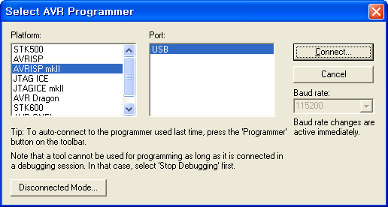
3) Firmware Download .
Click Icon.
Platform is select AVRISP mkII
And press Connect.

Slide 7
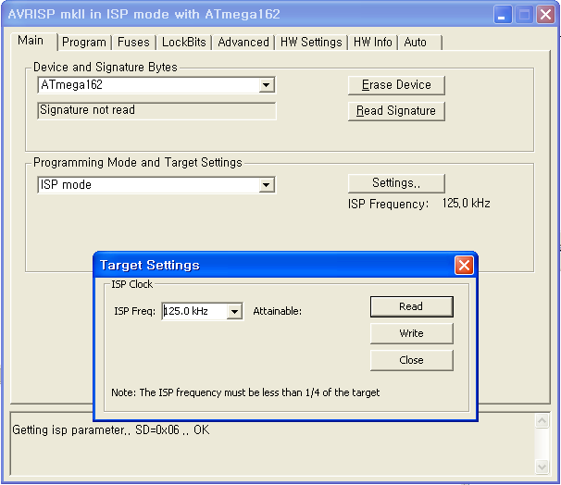
4) Reset moc.
Device and Signature Bytes selected
ATmega162 then click Erase Device
125 khz Press Write.

Slide 8
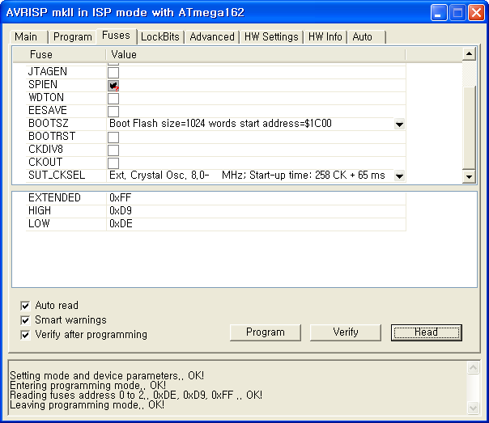
5) Fuse setting.
SPIEN is only checked.
Ext. Crystal Osc. 8.0 –
MHz; Start-up time: 258 CK + 65 ms
Select Program and Verify

Slide 9
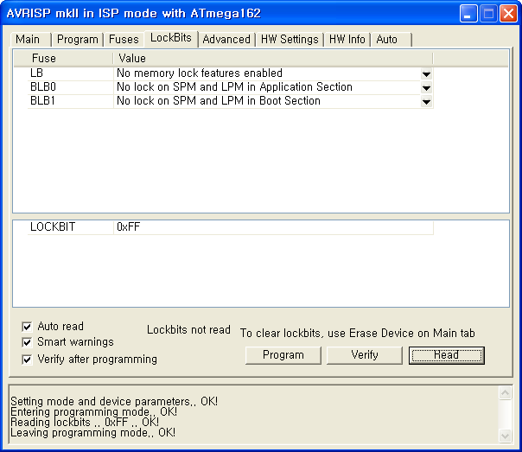
6) Lock Bits 설정합니다.
Press Program and Verify .

Slide 10
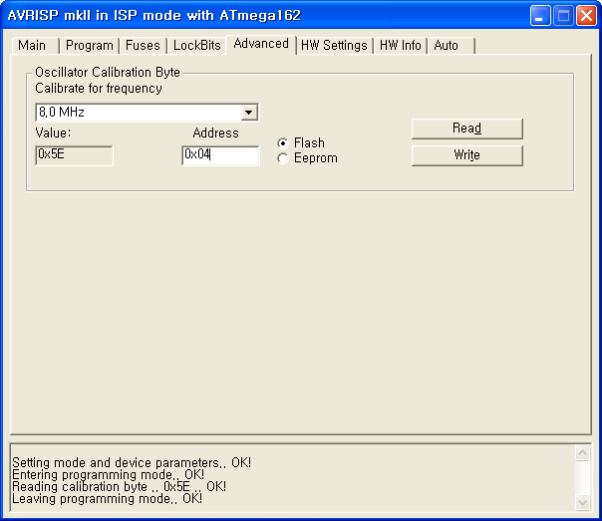
7) Advanced 설정합니다.
Read and Write.
Address가 0x04

Slide 11
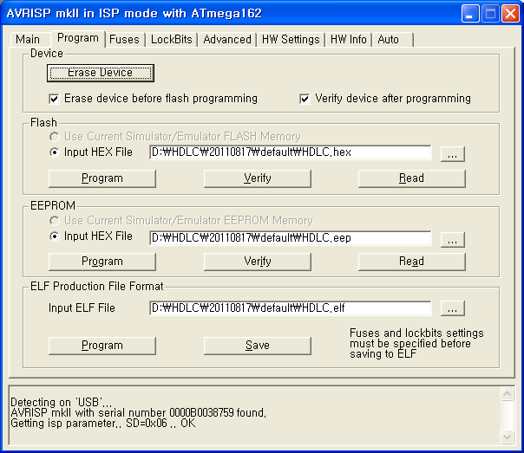
8) Program을 다운로드 합니다.
Erase .
HDLC.hex .
Program Verify .

Slide 12
● The End ●

